Slide 1
Small Project 3 Startup MACROSS
Arizki

Slide 2

Membangun Infrastruktur Berbasis Container Orchestration

Slide 3
Processing
Desain Infrastruktur Container
Membuat migrasi dari non Container ke Container
Mengintegrasikan Container Cluster dengan Layanan ASW
Menjalankan Layanan Orchestration Kubernetes dan ECS

Slide 4

TOPOLOGI INFRASTRUKTUR CLOUD

Slide 5
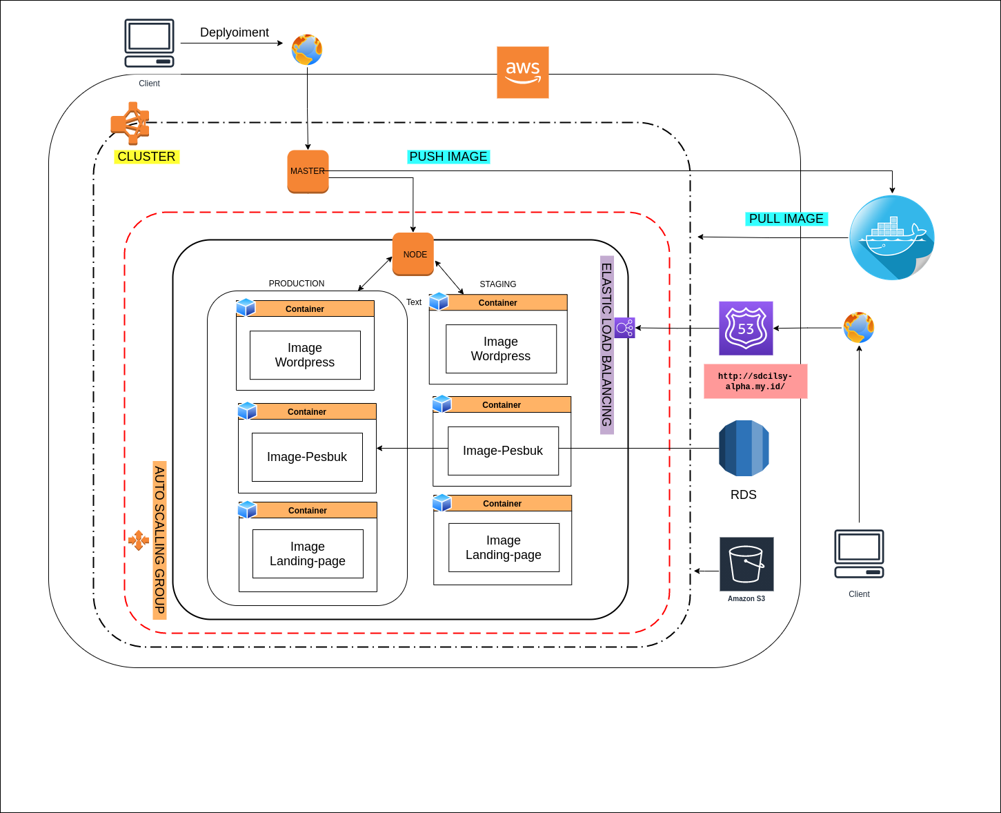
Topologi Insfrastruktur cloud

Slide 6
Budget Project Macross
BUDGET
No | Service | Spesifikasi | Monthly
1 | EC2 | Operating system (Linux) | 34.54 USD
 |  | Quantity (2)
 |  | Pricing strategy (EC2 Instance Savings Plans 1 Year No Upfront)
 |  | Storage amount (30 GB)
 |  | Instance type (Master: t3.Medium (22.05 USD)) & (Node: t3.Small (12.49 USD))
2 | RDS | Storage for each RDS instance (General Purpose SSD (gp2)) | 43.48 USD
 |  | Storage amount (20 GB)
 |  | Quantity (1)
 |  | Instance type (db.t2.micro)
 |  | Deployment option (Single-AZ)
 |  | Pricing strategy (OnDemand)"
3 | ELASTIC LOAD BALACING | Number of Classic Load Balancers (3) | 38.84 USD
 |  | Processed bytes per CLB (1 GB per month)
4 | AMAZON ROUTE 53 | Hosted Zones (1) | 0,50 USD
5 | S3 | S3 Standard Storage 3gb/mounth | 0.07 USD
 |  | First 12 months total | 1,409.16 USD
 |  | Total monthly | 117.43 USD

Slide 7
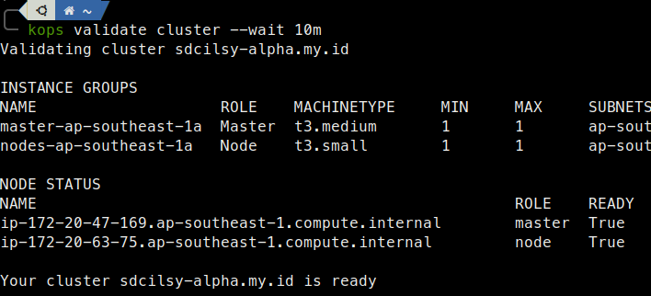
CLUSTER PROJECT

Slide 8
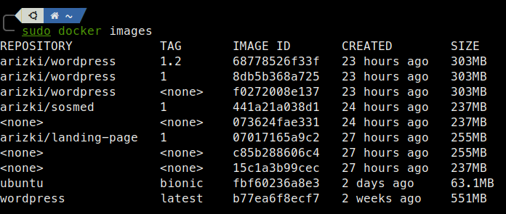
IMAGE PROJECT

Slide 9
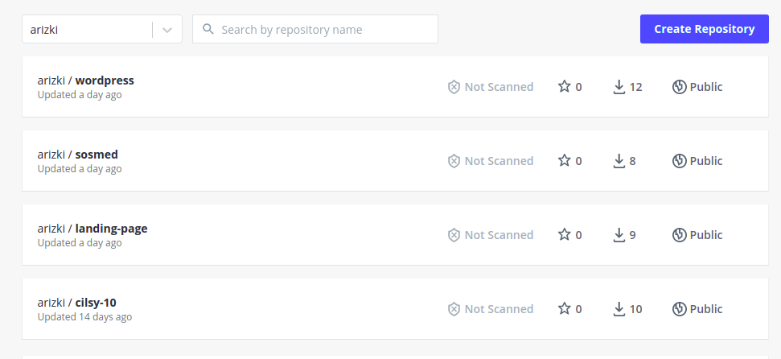
PUSH IMAGE ke DOCKERHUB

Slide 10
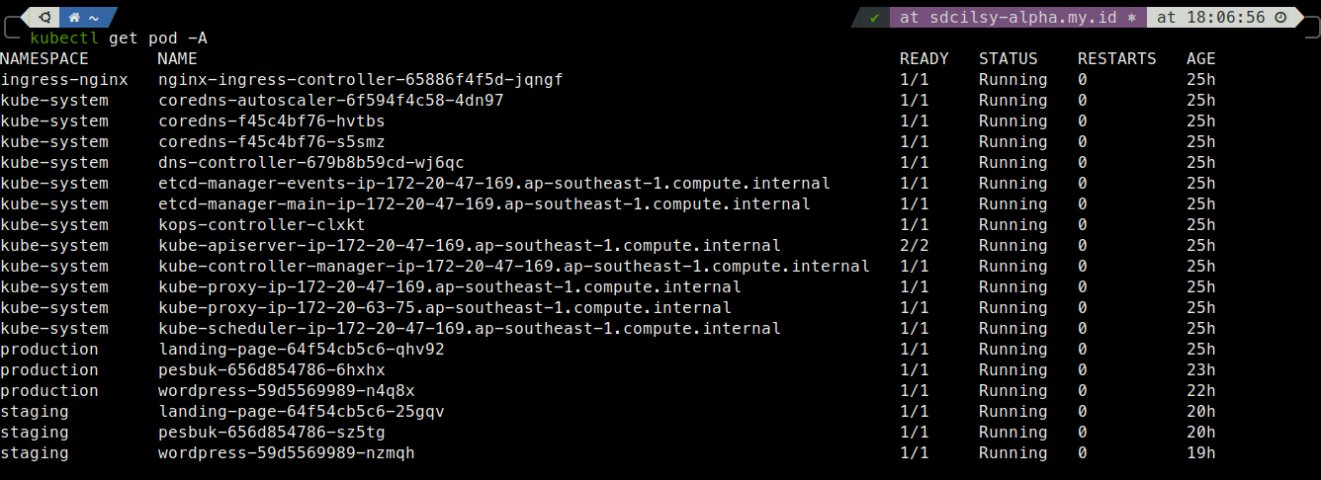
DEPLOYMENT PROJECT

Slide 11
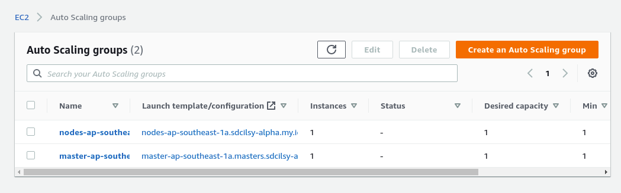
AUTO SCALLING

Slide 12
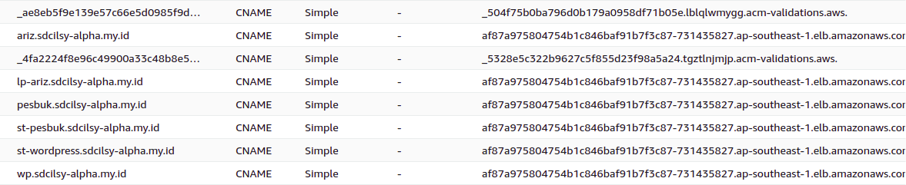
ROUTE 53

Slide 13
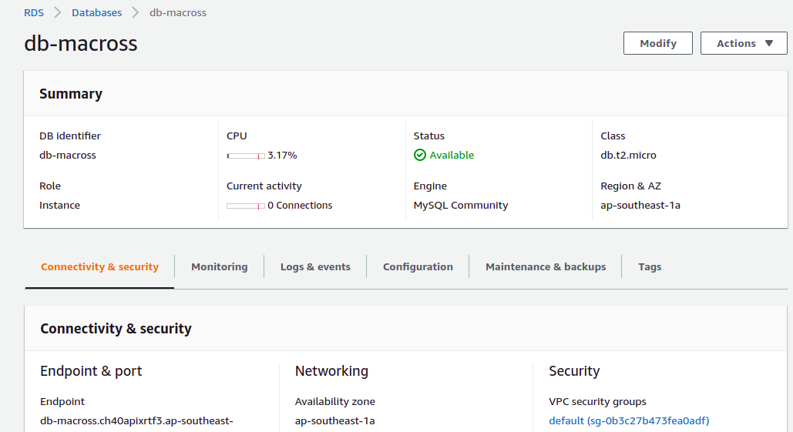
RDS Mysql

Slide 14
Terima kasih

